Slide 1

Time Series Forecasting Platform
(Brent Crude Oil)
Akil Mohamed Firos
Student id - 219015127
MSc AI for Business Intelligence
Academic Supervisor - Andrew Morozov
Sprint 1.1 Data Collection & Research

Slide 3
Dataset info
Main Target for the forecasting ($Y_{t}$) - Brent Crude Oil (collected via Yahoo Finance api)
Exogenous Variables ($X_{ }$) :
  These are the data collected to fulfil the requirement of mapping external market movers aka external factors to Brent Crude Oil price changes :
    Global Supply - OPEC+ Total Production Volumes
      To capture the supply targets since from the worlds largest oil cartels (aka producers) since they are the ones who cut or hikes directly the Brent pricing.
      Data collected from EIA Open Data Portal api
      Frequency is Monthly
    Currency – US Dollar Index (DXY)
      This is non-negotiable. Oil is priced in dollars; when the dollar moves, Brent moves.
      Data Collected from Yahoo Finance api
      Frequency is Daily
    Market Sentiment – VIX Index (VIX)
      This acts as a proxy for global economic fear and market sell-offs
      Data collected from Yahoo Finance api
      Frequency is Daily
    Arbitrage/Competitor – WTI Crude Oil Price (WTI)
      This gives my model the "Brent-WTI spread," which tells the model if cheaper US oil is flooding the global market.
      Data collected from Yahoo Finance api
      Frequency is Daily
Since the Frequency is varying all the fluctuations will be sampled into uniform weekly frequency (Friday Close).
The data collection period will be between 2019-2026.
( Exogenous Variables - acts as an input, affecting other variables inside the model without being influenced by them in return)

Slide 4
Machine Learning info
Before building out the model there are pre-preparation to do :
  ML Model don’t inherently understand the chronological date and time
  To tackle that the uniform weekly data frame is converted using a technique called Windowing / Lagging technique.
  The idea is to place the past metrics side by side with future targets in a tabular grid.
  This is the formula it will follow $Y_{t}=f(Y_{t−1} , X_{t−1})$
Model Category | ML Algorithm | How it affects Brent Dataset? | Project Purpose
Statistical Baseline | SARIMAX | Takes weekly Brent prices as the primary dependent variable (Y) and natively processes DXY, VIX, WTI, and OPEC data as an exogenous (X) matrix. | Parses traditional linear components to establish a hard econometric baseline.
Machine learning | XGBoost & Random Forest | Goes through chronological rows of tabular lag features (t-1, t-2) across all target and exogenous variables simultaneously. | Maps highly complex, non-linear market interactions (e.g., a massive OPEC supply drop paired with high market anxiety triggering an exponential price spike).
Future Selection | LASSO Regression | Tests linear combinations of the regressors and mathematically penalizes unhelpful variables by shrinking their coefficients to absolute zero. | Evaluates which external market drivers are genuinely influential, automatically filtering out the noise.
Deep Learning | LSTM Neural Network | Processes sequential weekly data arrays using internal "memory gates". | Preserves long-term structural supply shocks (like permanent OPEC+ quota shifts) without forgetting them as new weekly data streams in.
The regressor in the Lasso Regression is the historical data we feed to the model like the last week's oil prices, the strength of the US Dollar, and stock market fear, etc.

Slide 5
Time Series Forecasting Platform
(Brent Crude Oil)
Akil Mohamed Firos
Student id - 219015127
MSc AI for Business Intelligence
Academic Supervisor - Andrew Morozov
Sprint 2 - Model Building & Comparison

Slide 6
Table of Contents
Establishing the Benchmark: Linear Model Limitations
Hyperparameter Tuning & Error Reduction
Engineering for Machine Learning: Lags & Log-Space
Performance Comparison
Final Best Model Selection

Slide 7
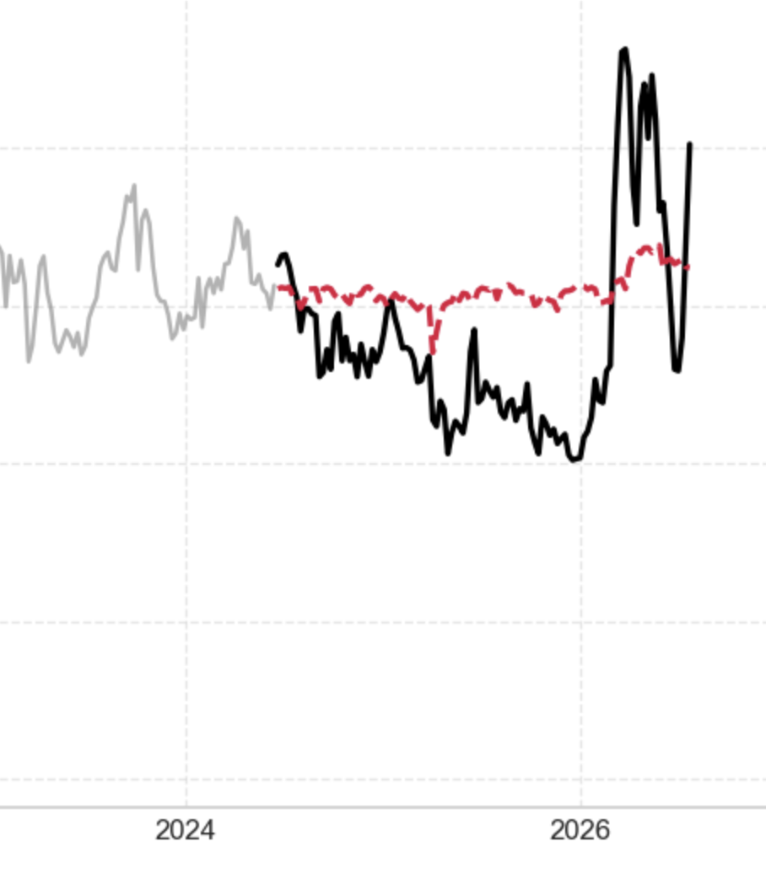
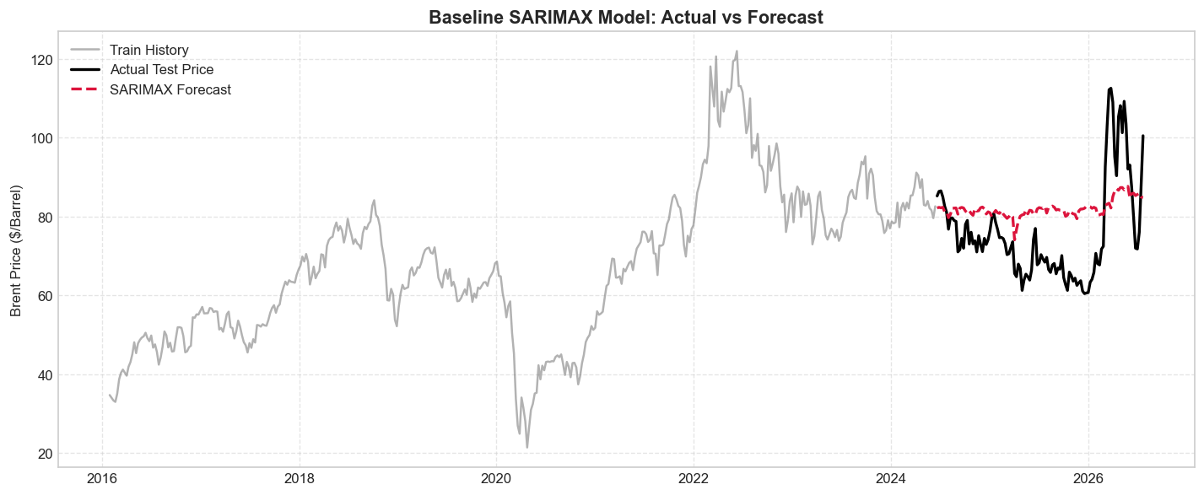
Establishing the Benchmark: Linear Model Limitations
Tested an un-tuned SARIMAX(1, 1, 1) model to establish a foundational performance metric.
Results: Mean Absolute Error (MAE) of $11.29 and a negative R² score (-0.08).
Conclusion: Linear state-space models fail to capture the severe, non-linear volatility of global commodity shocks without continuous rolling updates, in other words resulting $11.29 error and negative R² score mathematically proved our core hypothesis: traditional linear models cannot handle the complex volatility of the oil market.

Slide 8
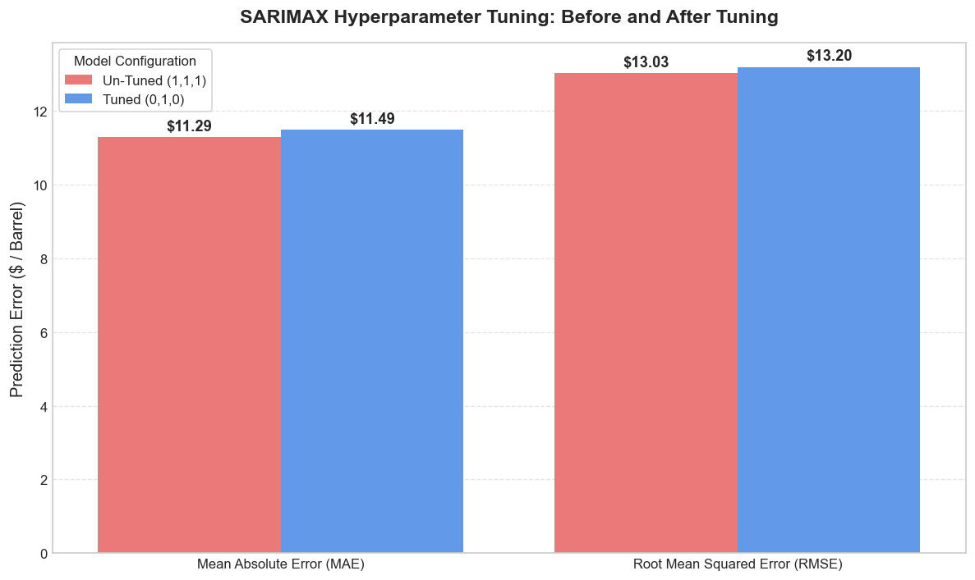
Hyperparameter Tuning & Error Reduction
Deployed an AIC-based Grid Search to rigorously optimize the SARIMAX parameters rather than relying on assumed estimates.
Optimal Configuration: The algorithm identified SARIMAX(0, 1, 0) as mathematically superior.
Impact: Reduced absolute and squared prediction errors, verifying our optimization pipeline works before transitioning to advanced algorithms.
These were the parameters I gave :
  “p” - for how many weeks look back
  “d” - prices changes week to week and this parameter tells me “how many times you must calculate the difference between consecutive weeks to make the overall trend flat which I set to 1 since I have known from sprint 1.2 that Brent_Crude Oil is non-stationery.
  “q” – tells me “how many past forecast errors the model looks at to correct its current trajectory for its next forecast”.
  I put above parameter into the itertool lib to generate diff combination of p,d,q and then ran them into the sarimax model parameter loop for each combination generated.
  The result being the model mathematical superior chosen config.

Slide 9
Engineering for Machine Learning: Lags & Log-Space
Data Transformation: Converted chronological time-series data into a supervised learning matrix.
Lagged Features: Engineered "short-term memory" by feeding the algorithms the exact prices from the previous 1, 2, and 3 weeks.
Target Normalization: Trained all models strictly on Log-Normalized prices (under the var_name Brent_Log) to stabilize extreme variance, converting predictions back to raw US dollars (using the np.expm1) only for final evaluation.
*Calculates log exp(x) - 1 with high precision for numbers close to zero.

Slide 10
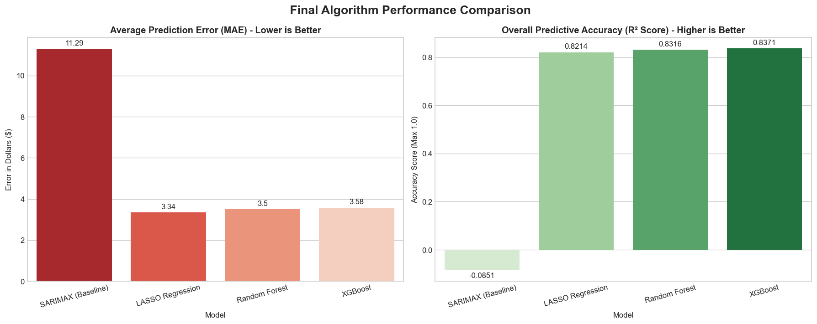
Performance Comparison
The Contenders: SARIMAX vs LASSO Regression (Linear) ,Random Forest & XGBoost (Tree-based ML).
The Improvement: All ML models slashed the $11.29 baseline error down to the ~$3.50 range.
Accuracy Jump: R² scores increased from a failing baseline to explaining over 83% of all market variance.
* The below Bar Chart is output visualization after doing config work on there parameters for each model.

Slide 11
Final Best Model Selection
Model | MAE | RMSE | R^2
SARIMAX (Baseline) | 11.29 | 13.03 | -0.0851 = -0.8%
LASSO Regression | 3.34 | 5.30 | 0.8214 = 82.14%
Random Forest | 3.50 | 5.15 | 0.8316 = 83.16%
XGBoost | 3.58 | 5.06 | 0.8371 = 83.71%
LASSO vs. XGBoost: While LASSO achieved a slightly lower average error ($3.34), XGBoost is the superior architectural choice for volatile commodities.
Why XGBoost Won: Highest overall predictive accuracy (R² = 0.837) and the lowest Root Mean Squared Error (RMSE = 5.06).
Strategic Advantage: The lowest RMSE proves XGBoost is mathematically the safest and most robust model when faced with extreme, unpredictable market panics.
In the next slide a line chart visualization will be available to further understand why XGBoost comes out on top as the best model in the selection.
* Mean Absolute Error (MAE) - tells you exactly how many dollars your model's prediction is off by, on average, every single week. So lower is always better.
* R^2 - tells you what percentage of the wild price swings (volatility) in the oil market your model successfully mapped and predicted.

Slide 12
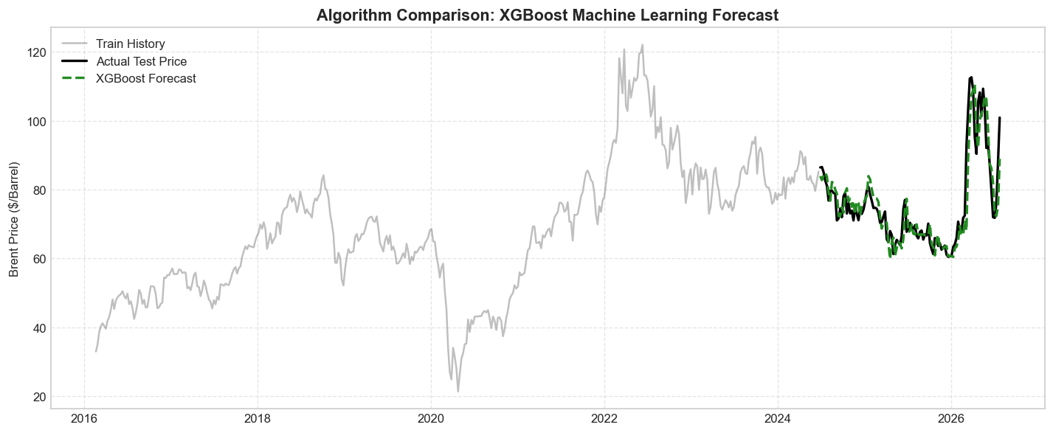
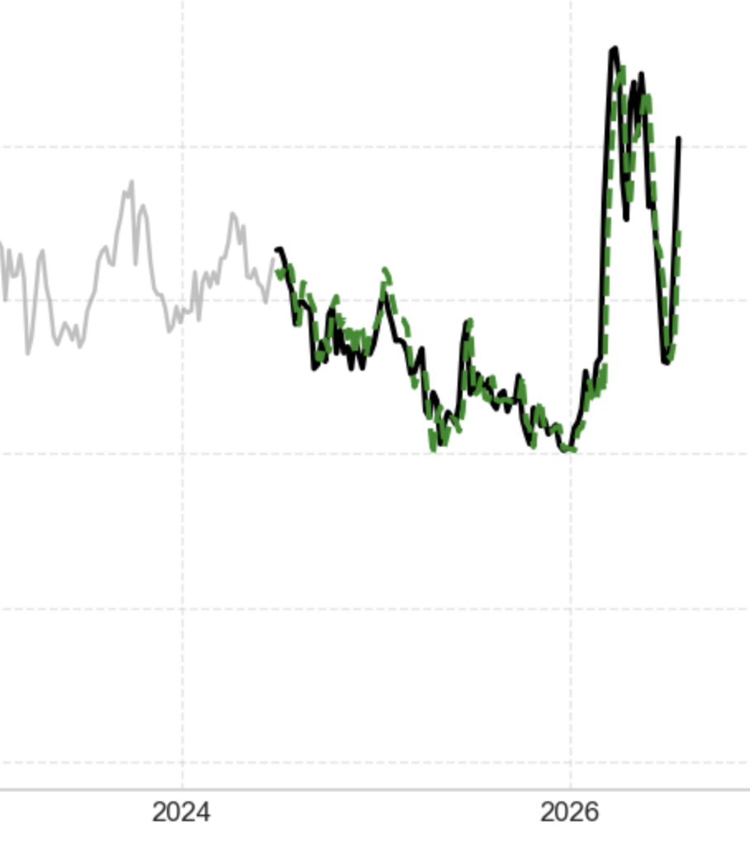

Slide 13
Time Series Forecasting Platform
(Brent Crude Oil)
Akil Mohamed Firos
Student id - 219015127
MSc AI for Business Intelligence
Academic Supervisor - Andrew Morozov
Sprint 3.1 - Initial Platform Building

Slide 14
Table of Contents
Sprint 3.1 Key Accomplishments
System Architecture & Data Pipeline changes
Core Dashboard Modules
Planned Enhancements

Slide 15
Sprint 3.1 Key Accomplishments
Transitioned offline Jupyter notebook experiments to a modular backend (src/data_loader.py & src/models_engine.py).
Built live market indicator cards (Brent Spot, WTI, DXY Index, VIX Volatility).
Implemented an interactive multi-model forecast visualizer with Plotly.
Integrated a live model evaluation matrix ($MAE, RMSE, R^2, MAPE$).
Embedded a historical dataset explorer & summary statistics inspector.

Slide 16
System Architecture & Data Pipeline changes
Data Loader (data_loader.py): Raw dataset ingestion, log transformations (Brent_Log), and automated feature engineering (lags 1–3, DXY/VIX/OPEC Z-score normalization).
The notebook dir will now be used as the testing environment for new models to be built before deploying it onto the dashboard.
Models Engine (models_engine.py): Unified execution across all models using a 80/20 chronological split (maintaining temporal order).
Streamlit App (app.py): Fast frontend rendering with @st.cache_data caching.

Slide 17
Core Dashboard Modules
Market KPI Metrics Bar: Live tracking of crude spot prices & daily price deltas.
Plotly Forecast Visualizer: Interactive line chart with hover crosshairs, zooming, and toggleable model traces.
Model Performance Matrix: Side-by-side comparative table ($MAE, RMSE, R^2, MAPE$).
Historical Data Inspector: Expandable dataset viewer & summary metrics (describe()).

Slide 18
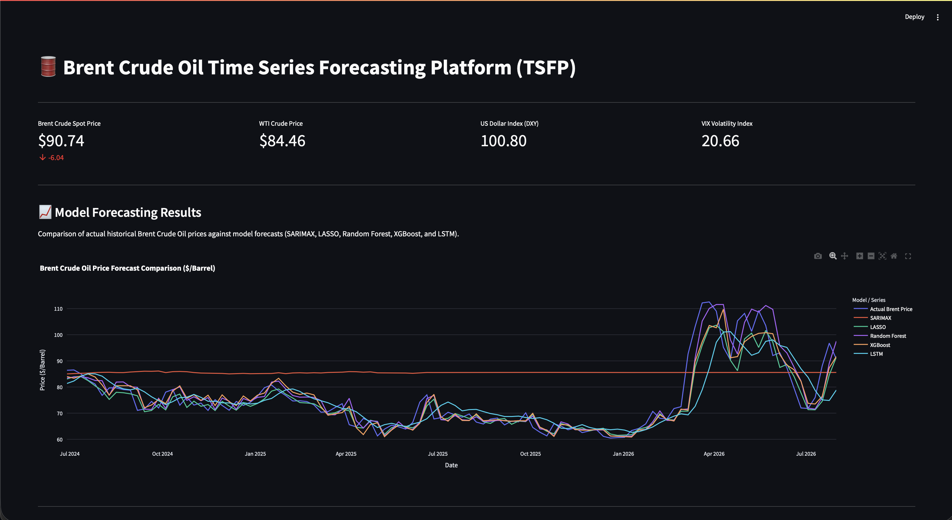

Slide 19
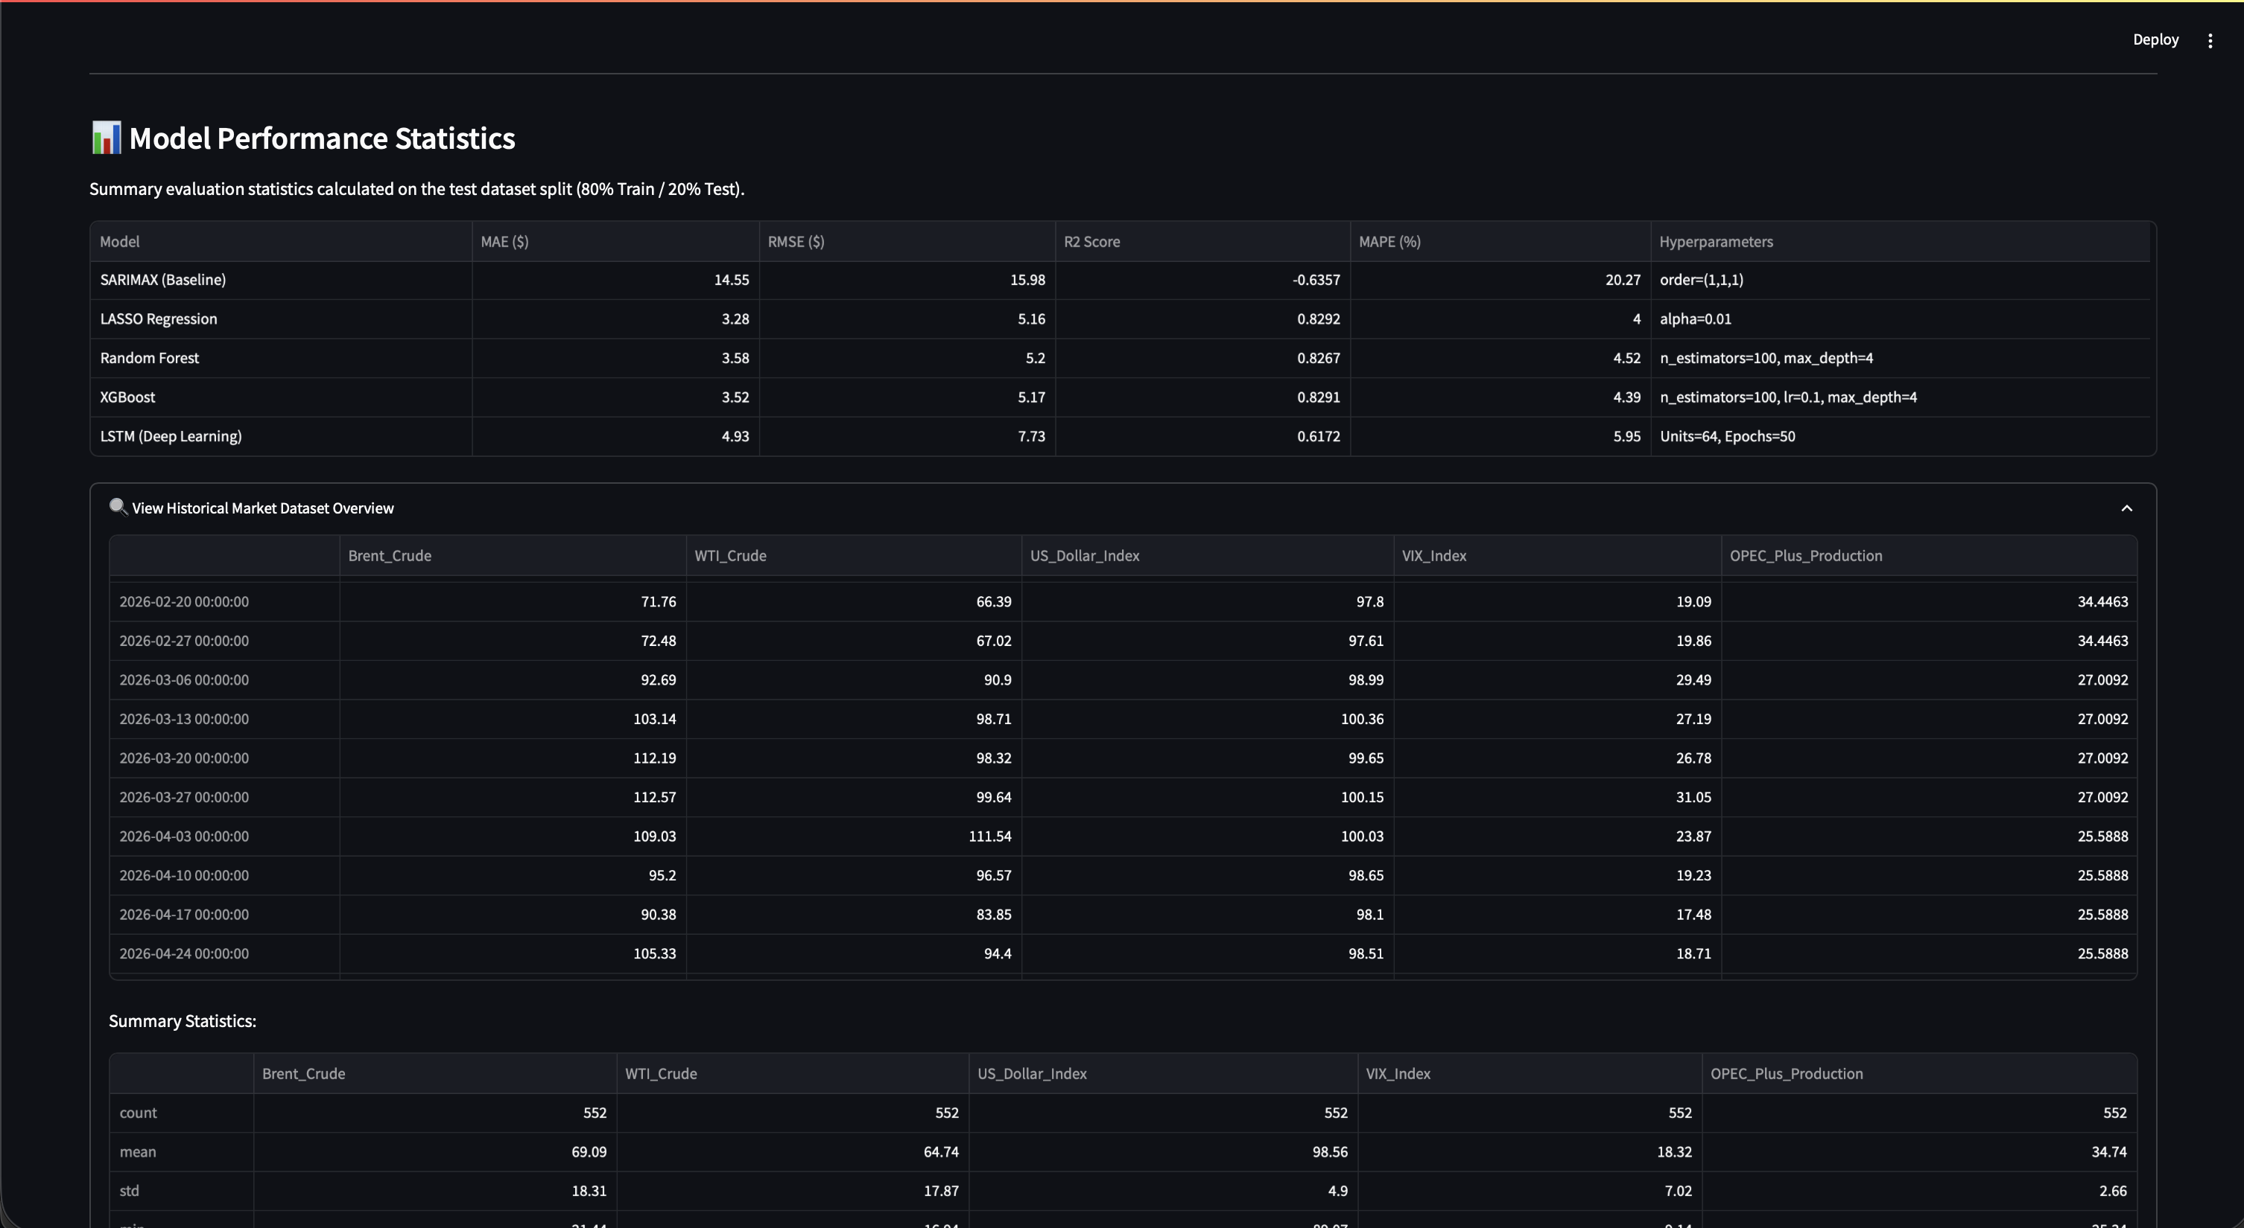

Slide 20
Planned Enhancements
Custom CSV Upload: Interactive upload feature for custom market datasets.
Dynamic Model Hyperparameter Tuning: Sidebar controls to adjust parameters on-the-fly.
Automated Data Fetching: Live API integration for real-time market data ingestion.
Adding Risk Metric / Risk-Adjusted Decision Indicator
Need to answer to the needs of two kinds of audience :
  You have the professional audience where for them they will go in-depth into the data asking the question why should I buy at this price, or why should I sell now ,all the advanced thinking ? So, a visualization appropriate to them is needed.
  You have the unprofessional audience where to them they don’t know much about the info I am giving them and just want a quick overview of what to do. Like what is the condition right now and should I buy or sell, if I buy now how much PnL would I make over a certain period, etc.
The chart needs to be more interactive, meaning say for the model chart on the side you could have a drop-down list containing the years and for that selected year you can show the results for that particular year and when you reset it shows chart till current date.

Slide 21
Time Series Forecasting Platform
(Brent Crude Oil)
Akil Mohamed Firos
Student id - 219015127
MSc AI for Business Intelligence
Academic Supervisor - Andrew Morozov
Sprint 4.1 Validation and Visualisation

Slide 22
Table of Contents
Objectives & Methodology
Out-of-Time Trajectory Analysis
Cross-Era Performance Indicators
Model Stability & Predictor Drivers

Slide 23
Objectives & Methodology
Sprint Goal: Stress-test the best-performing models on an unseen secondary dataset to verify generalization and guard against modern-era overfitting.
Secondary Dataset Setup:
  Era: Historical Market Regime (2007–2015) | $N = 437$ weekly observations.
  Context: Encompasses the 2008 Great Financial Crisis, capturing extreme Brent crude price swings (peaking at >$140/bbl before dropping to ~$35/bbl).
Validated Models: Selected top-performing tree-based architecture LightGBM and XGBoost.

Slide 24
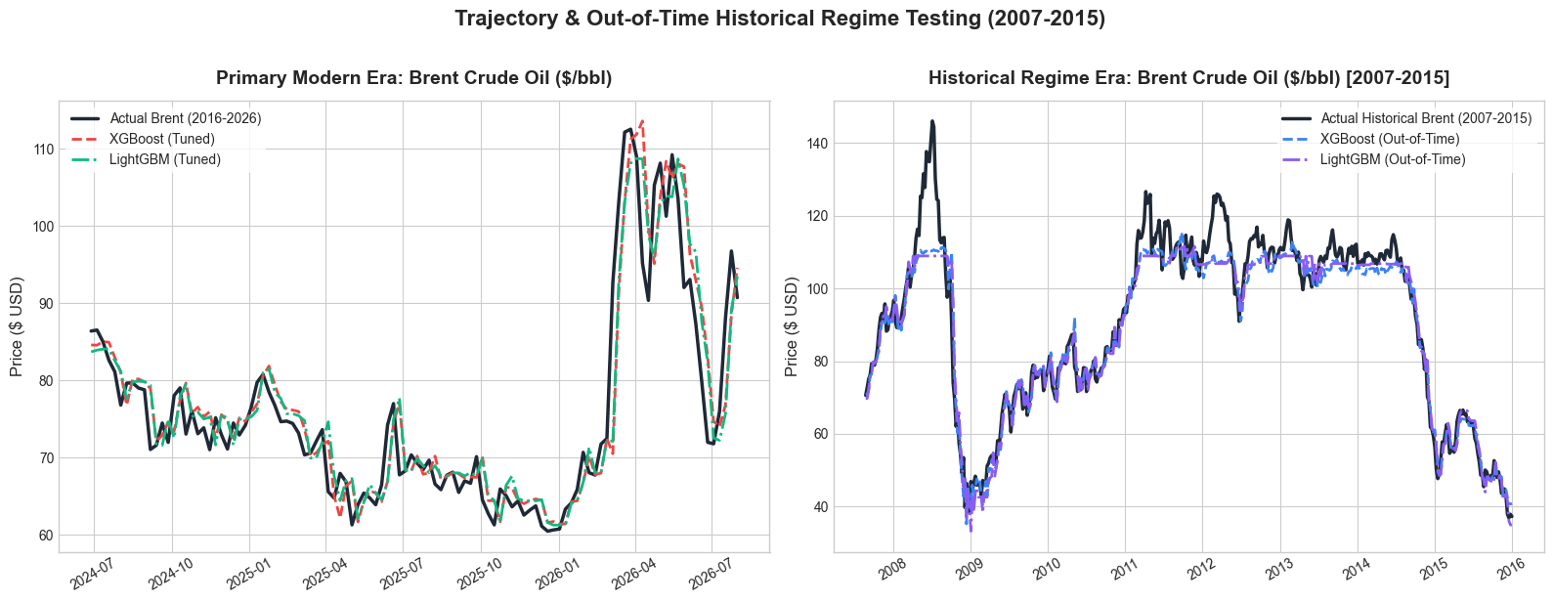
Out-of-Time Trajectory Analysis
Modern Era (2016–2026):
  Both models closely follow modern price dynamics ($ MAE ~3.40$).
  LightGBM slightly edges out XGBoost on overall error fit ($RMSE = 4.85$ vs. 5.07$).
Historical Crisis Era (2007–2015):
  Neither model diverged during rapid structural shifts or market crashes.
  High-volatility peaks produced temporary under-prediction, typical of non-linear tree models encountering extreme unseen price ceilings.

Slide 25

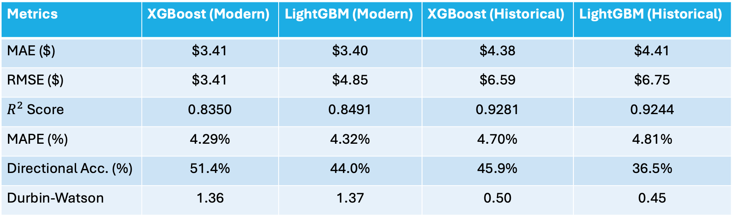
Cross-Era Performance Indicators
Metrics | XGBoost (Modern) | LightGBM (Modern) | XGBoost (Historical) | LightGBM (Historical)
MAE ($) | $3.41 | $3.40 | $4.38 | $4.41
RMSE ($) | $3.41 | $4.85 | $6.59 | $6.75
$R^{2}$Score | 0.8350 | 0.8491 | 0.9281 | 0.9244
MAPE (%) | 4.29% | 4.32% | 4.70% | 4.81%
Directional Acc. (%) | 51.4% | 44.0% | 45.9% | 36.5%
Durbin-Watson | 1.36 | 1.37 | 0.50 | 0.45
Key Take aways:
Strong Trend Capture: $R^{2}$increased to >0.92 in the historical era, confirming excellent fit across wide swings.
Stable Scale Error: MAPE remained under 4.81% across all testing environments.
Absolute Error Increase: Absolute dollar errors (MAE/RMSE) rose during 2007–2015 due to higher nominal oil prices during that era.

Slide 26
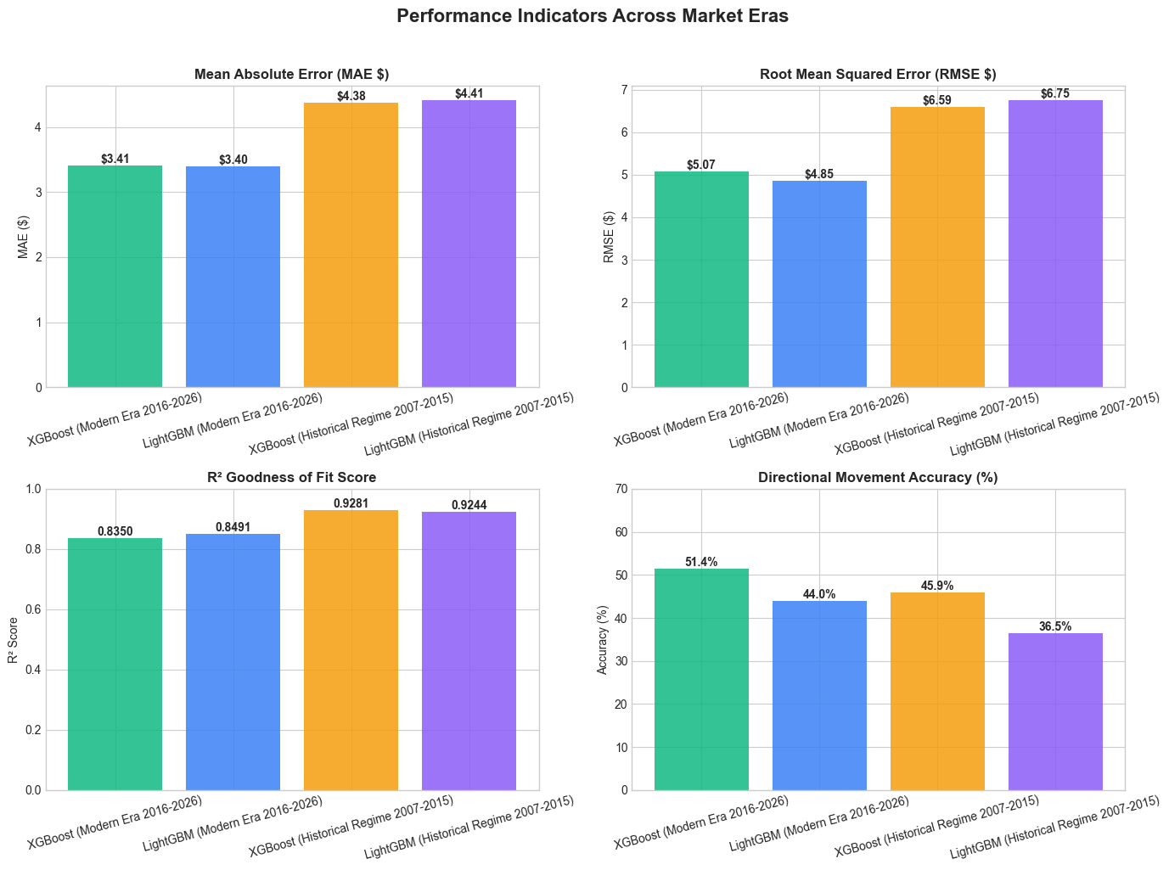

Slide 27
Model Stability & Predictor Drivers
Error Density Symmetry:
  Residual error distributions for both eras are narrow, zero-centered bell curves, showing negligible systematic bias.
  Historical residuals exhibit slightly broader tails due to 2008 volatility spikes.
Feature Drivers:
  Price_Lag_1 dominates feature importance for LightGBM, backed by macroeconomic features (VIX_Z, OPEC_Z, and USD_Z).
Autocorrelation (Durbin-Watson):
  Scores near ~1.37 in the modern era indicate mild positive autocorrelation, while historical scores (~ 0.45 - 0.50) reflect error persistence during crisis regimes.

Slide 28


